Slide 1
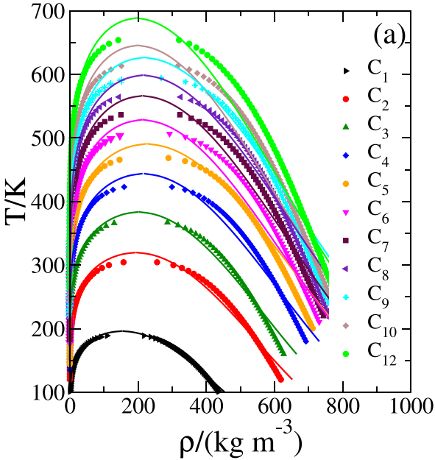
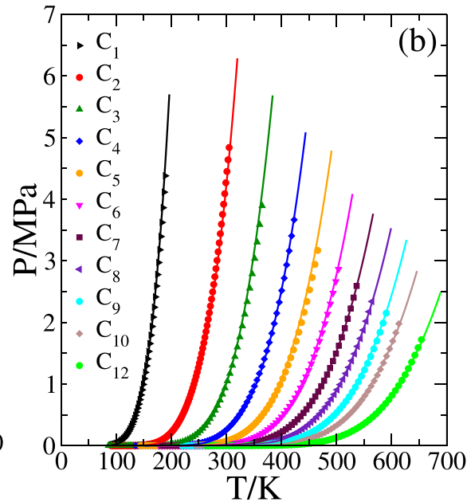
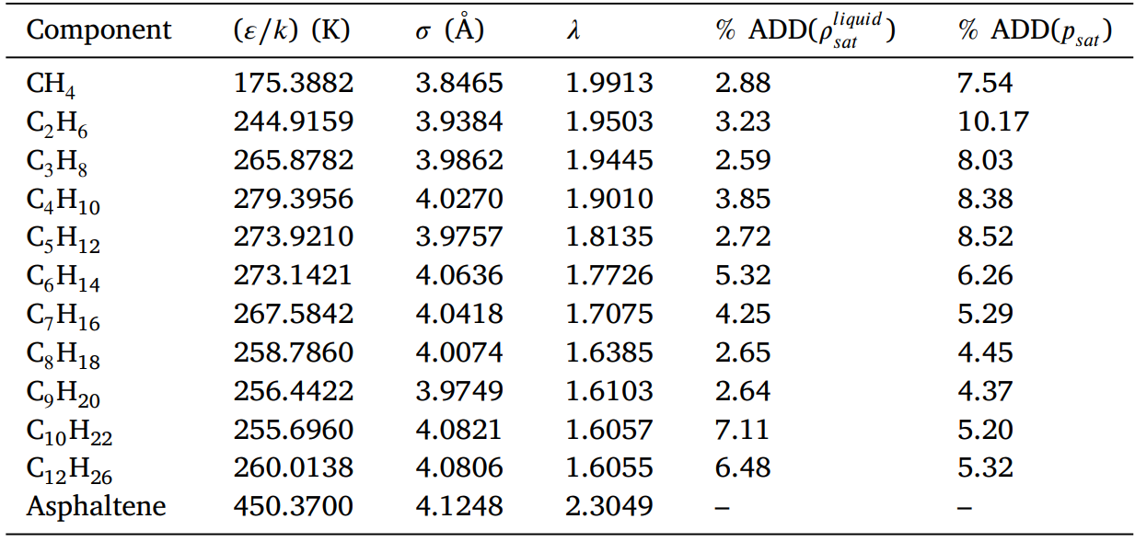
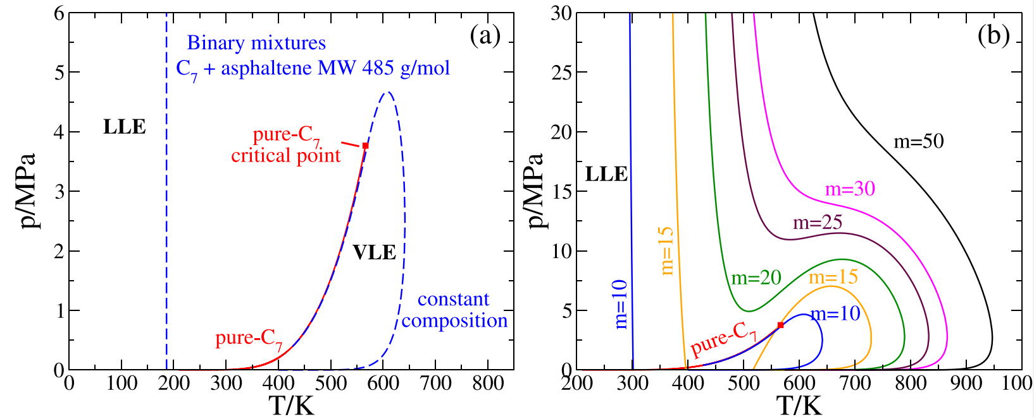
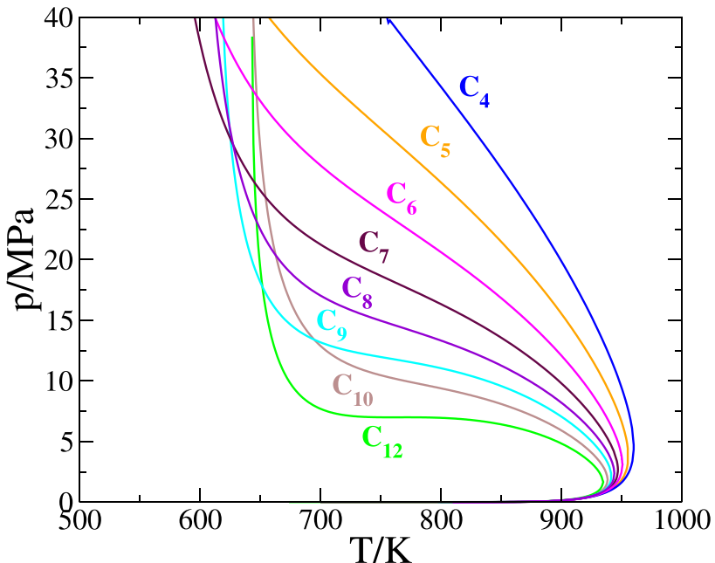
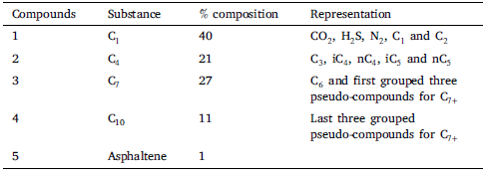
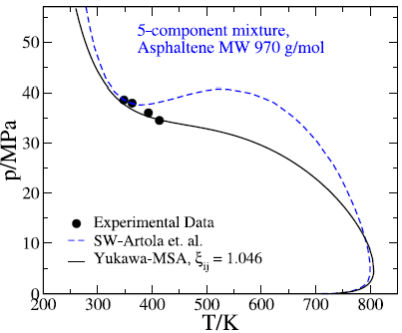
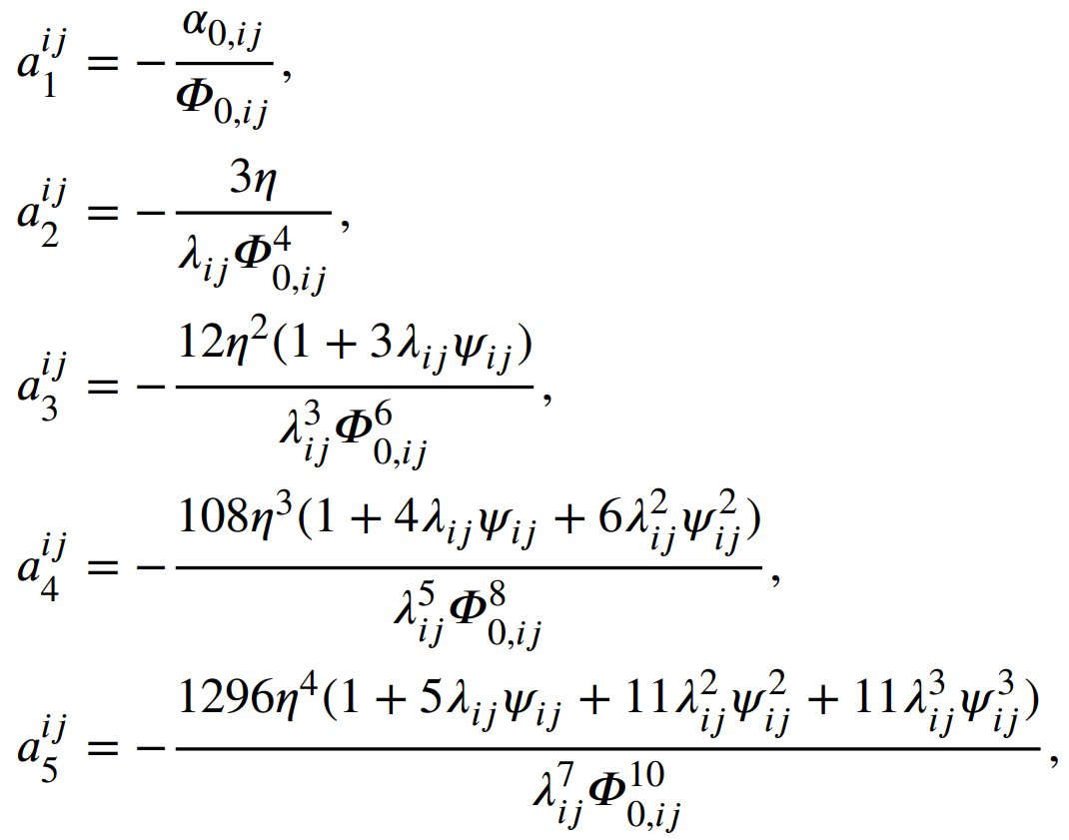
* To whom correspondence should be addressed. Email: clira@imp.mx
Abstract
Results – Pure fluids
We combine the Statistical Associating Fluid Theory for Potentials of Variable Range (SAFT-VR) and the Mean Spherical Approximation (MSA) to develop an equation of state (EOS) to model asphaltene precipitation in petroleum fluids including the measured asphaltene onset-pressures (AOP’s) of a reservoir live oil. In this model, dispersive solvent–solvent and asphaltene–solvent interactions in reservoir fluids are represented by Yukawa potentials. The approach is based in the modeling of polar and ionic interactions via Yukawa potentials, as originally proposed by the Generalized Mean Spherical Approximation Theory, and also in recent studies in molecular simulation of charged fluids using non-Ewald effective pair interactions, as in the Wolf method
Introduction
Fig. 1 Prediction for saturation properties of n-alkanes. Panel (a): Saturated vapor and liquid densities. Panel (b): Vapor pressure.
Table 1. Optimized pure-component parameters to vapor pressure and liquid density data.
The Yukawa potential provides a natural system to model polar and charged fluids within the Generalized Mean Spherical Approximation (GMSA) [1]. This approach allows to solve the Ornstein–Zernike integral equation using an extended version of the Mean-Spherical Approximation (MSA),
Binary mixtures
The superior performance of the Yukawa SAFT-VR EOS approach to model solubilities of substances of interest in the pharmaceutical industry has been recently reported in [2]. Based on the same approaches used by Wu et al. [3], Buenrostro–Gonzalez et al. [4], and the Mean Spherical Approximation for Yukawa fluids [5], we propose here a primitive model to effectively describe the electrostatic behavior of asphaltenes as molecules whose monomers interact via the Yukawa pair potential, with no associating sites. We test the validity of this new EOS by reproducing the phase diagrams of typical asphaltenic oils including a reservoir fluid where measured AOP’s are available.
Fig. 2. Constant-composition 𝑝 − 𝑇 phase diagrams of binary mixtures of a light oil 𝐶₇ + 1 mol%, Panel (a): Single phase region for 𝐶₇ + 1 mol% with 𝑚𝑎𝑠𝑝 = 10. The pure-𝐶₇ vapor pressure is indicated by a continuous red curve, ending at the 𝐶₇ and 𝑚𝑎𝑠𝑝 = 10 critical point. Panel (b): Asphaltene with different lengths: 𝑚𝑎𝑠𝑝 = 10, 20, 30, 40 and 50. The pure-𝐶₇ vapor–pressure is indicated by a continuous red curve, ending at the 𝐶₇ critical point. Panel (b): Constant-composition 𝑝 − 𝑇 AOP-phase diagrams of binary mixtures for 𝐶_{𝑛} (n = 4, 5, 6, 7, 8, 9, 10 and 12) + 1 mol% asphaltene 𝑚𝑎𝑠𝑝 = 50.
Statistical Mechanics Model
We consider mixtures of chain molecules for 𝑛-𝑐 -substances, formed by 𝑚-𝑖 spherical segments of diameter 𝜎𝑖,𝑗 , where 𝑖, 𝑗 denote the i-th and j-th components of the mixture. Monomer interactions are described by pairwise hard-core Yukawa potentials, for monomers 𝑖, 𝑗 separated by a distance 𝑟,
Reservoir live-oil [4]
The corresponding Helmholtz free energy is given by the SAFT-VR perturbation expansion, considering that the Yukawa model is a variable-ranged interaction [6]
Table 2. Composition of the 5-compounds mixture based in [8]. Asphaltene molecular weight is 970 g/ mol⁻¹, corresponding to 𝑚 = 20. Characterization is similar to the one reported by Artola et al. a [9]. C𝑛 parameters are given in Table 1.
Fig. 3. Experimental [4] vs. calculated AOP curve.
Conclusions
Following the SAFT-VR approach for mixtures Mx2b in [7], the perturbation terms of the mixture are given by
We have presented a new Yukawa/MSA equation of state for modeling asphaltene precipitation phenomena in petroleum reservoir fluids, using the thermodynamic approach for mixtures according to the SAFTVR approach [7]. The new EOS provides a method for incorporating electrostatic effects of polar asphaltenic oils and suspensions where ionic and polar interactions are modeled via effective Yukawa pair potential interactions of variable range. The extra range parameter 𝜆 takes into account the real effect of variation of the electrostatic interactions due to screening effects as well as the competing interactions present in complex solutions as the ones found in oil fluids, and the SAFT-VR approach offers the advantage of taking a rigorous modeling of variable ranged systems in comparison with other SAFT versions, as we also have highlighted in a previous study using a SAFT-VR squarewell description of asphaltenes [4, 10]. All features of asphaltene phase diagrams including AOP’s in real reservoir mixtures can be modeled satisfactorily, thereby recommending its use for process design and simulation in reservoir and production processes of the oil industry.
Acknowledgmnts
AM-B thanks Tecnologico de Monterrey in Leon for the high-performance computing facilities used in this work. Support from University of Guanajuato, Grant DAIP-CIIC 250/2023 (AG-V) is gratefully acknowledged. CL-G is thankful to the Branch of Product Technology (DTP) of the Mexican Institute of Petroleum, project H-61096, for permission to present this work.
References
The chain term, A^{chain}/NkT is given in [8].
[1] J.S. Hoye, J.L. Lebowitz, G. Stell, Generalized mean spherical approximations for polar and ionic fluids, J. Chem. Phys. 61 (1974) 3253–3260.
[2] S. Hazaveie, G. Sodeifian, S. Sajadian, Measurement and thermodynamic modeling of solubility of Tamsulosin drug (anti cancer and anti-prostatic tumor activity) in supercritical carbon dioxide, J. Supercrit. Fluids 163 (2020) 253.
[3] Wu, J., Prausnitz, J.M. and A. Firoozabadi, Molecular thermodynamics of asphaltene precipitation in reservoir fluids, AIChE J. 46 (2000) 197.
[4] E. Buenrostro-Gonzalez, C. Lira-Galeana, A. Gil-Villegas, J. Wu, Asphaltene precipitation in crude oils: Theory and experiments, AIChE J. 50 (10) (2004) 2552–2570.
[5] D. Henderson, L. Blum, J.P. Noworyta, Inverse temperature expansion of some parameters arising from the solution of the mean spherical approximation integral equation for a Yukawa fluid, J. Chem. Phys. 102 (1995) 4973–4975.
[6] A. Gil-Villegas, A. Galindo, P.J. Whitehead, S.J. Mills, G. Jackson, A.N. Burgess, Statistical associating fluid theory for chain molecules with attractive potentials of variable range, J. Chem. Phys. 106 (1997) 4168–4186.
[7] L.A. Davies, A. Galindo, A. Gil-Villegas, G. Jackson, The thermodynamics of mixtures and the corresponding mixing rules in the SAFT-VR approach for potentials of variable range, Mol. Phys. 93 (2) (1998) 241–252.
[8] Martinez-Borquez, A., Gil-Villegas, A. and C. Lira-Galeana Fluid Phase Equilibria, In Pres (2023).
[9] P.-A. Artola, F.E. Pereira, C.S. Adjiman, A. Galindo, A.J.H. Erich A. Muller, Understanding the fluid phase behaviour of crude oil: Asphaltene precipitation, Fluid Phase Equilib. 306 (2011) 8659–8665.
[10] M. Castro, J.L.M. de la Cruz, E. Buenrostro-Gonzalez, S. Lopez-Ramirez, A. Gil-Villegas, Predicting adsorption isotherms of asphaltenes in porous materials, Fluid Phase Equilib. 286 (2009) 113–119.
Helmholtz free energy is known, chemical potentials (𝜇_{𝑖}), pressure (𝑃 ) and compressibility factor (𝑍) are obtained from the standard thermodynamic relations
Phase equilibrium calculations in asphaltene-containing systems are then performed using well-known stability and phase-split approaches due to Michelsen. In the following examples, we illustrate the capabilities of the proposed new EOS in calculating all features of asphaltenic-oil phase diagrams, including the AOP´s of a reservoir fluid from a Southeast producing facility in Mexico, were measured data are available [4].

